Slide 1
Case Study 4: GlowUp’s Marketing Campaign ROI Analysis FY 2025
Sai Jhansi Kongara
Student at Sharpener Tech

Slide 2
AIM
Analyze GlowUp’s Marketing Campaign ROI Analysis, a beauty and skincare startup that recently ran multiple online and offline marketing campaigns. to provide necessary business recommendations to identify which campaigns and channels generate the highest ROI
Business Objectives
Identify the most effective campaigns in terms of conversions and revenue.
Calculate ROI for each campaign.
Recommend budget allocation for future campaigns to maximize impact.
Tools Used:
Microsoft Power BI
Spreadsheet
ChatGPT

Slide 3

Business Analysis

Slide 4
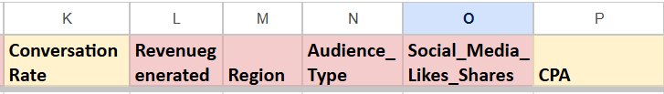
Dataset & Preparation
Chatgpt driven Dataset.
Replacing null Values are with “0”.
Blank Text entries with “Unknown".
Conversion Rate = Conversions / Leads * 100
CPA =Spend/Conversions
CPA ↓ =More Efficient
4000 GlowUp Marketing Campaign ROI Analysis Data Entries FY 2025

Slide 5
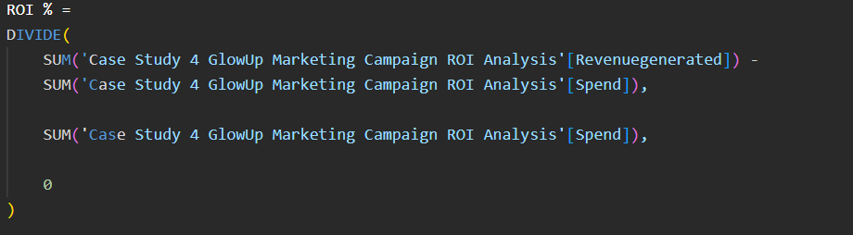

DAX Measures
It measures how much profit is earned from the (spend) i.e, money invested in a campaign, project, or business activity.

Slide 6
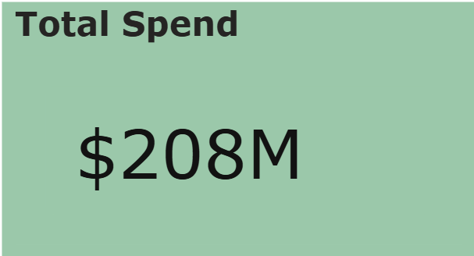
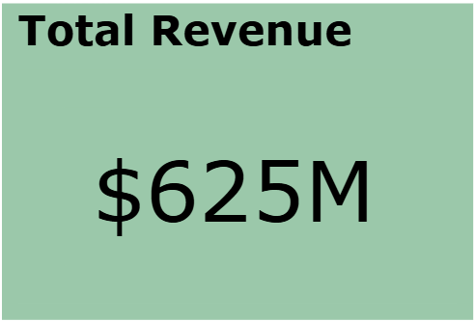
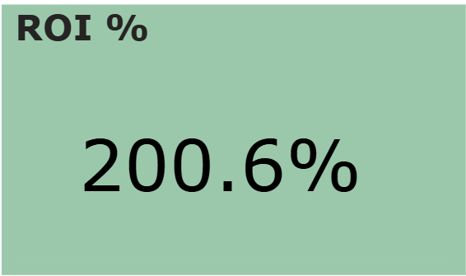
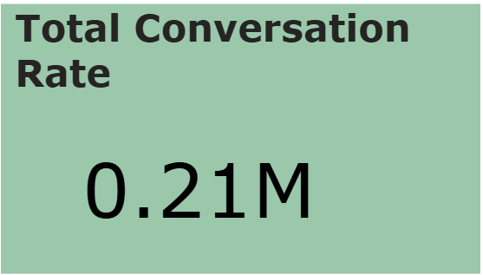
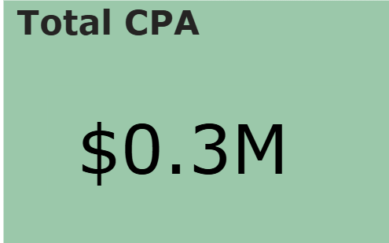
KPI Summary
For every 100$ spend we generated 300$, so 200$ is the profit.
An ROI of 200% means that for every $100 invested in marketing, the company generated $300 in revenue and earned $200 as profit.
Total Conversion Rate: This KPI measures the percentage of leads converted into customers.
CPA — Cost Per Acquisition: CPA measures how much money is spent towards each conversation.

Slide 7
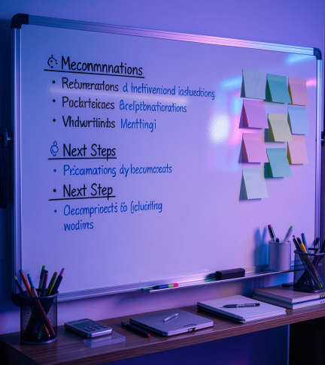
Business Insights and Recommendations
in terms of Quick wins and long-term strategies

Slide 8
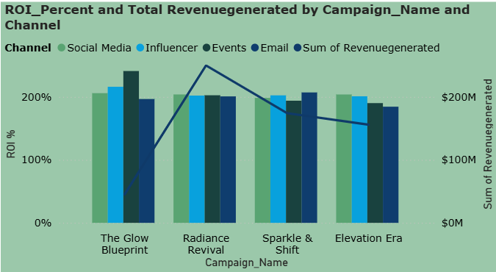
Revenue Trends
4 Campaigns and 4 Channels
High ROI: The Glow Blueprint
Highest Revenue generated: Radiance Revival
best campaign

Slide 9
Revenue Trends
Quick wins(0–3 Months) : Recommendations to actions
Increase budget allocation toward high-ROI campaigns with strong revenue performance.
Reuse successful campaign strategies and creatives to maximize short-term profitability.
Long-Term Strategies (3–12 Months)
Build long-term partnerships with high-performing influencers.

Slide 10
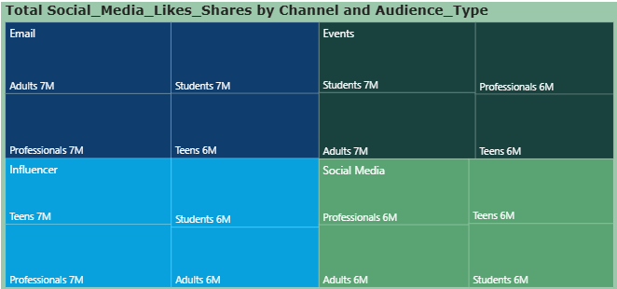
Audience Engagement Across Marketing Channels and Audience Type.
A tree map
Categories: Channel
details: Audience Type
values: Social media likes shares
Social Media has less response Comparatively.

Slide 11
Audience Engagement Across Marketing Channels and Audience Type
Quick wins:
Retarget social media leads to improve conversions.
Long-term strategies:
By understanding which audience groups generate higher likes, shares, leads, and conversions, GlowUp can create more personalized campaigns that match customer interests and preferences.

Slide 12
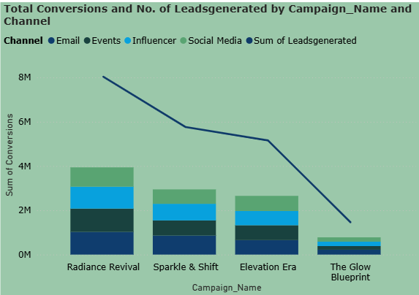
Channel Analysis
Radiance Revival converted most of the leads into Conversations.
Best and worst performing campaign across all channels

Slide 13
Channel Analysis
Quick wins:
Retarget high-potential leads from Social Media campaigns as people are actively searching for products mainly adults
Long-term strategies:
Enhance customer engagement strategies through Surveys to improve conversion rates and revenue growth

Slide 14
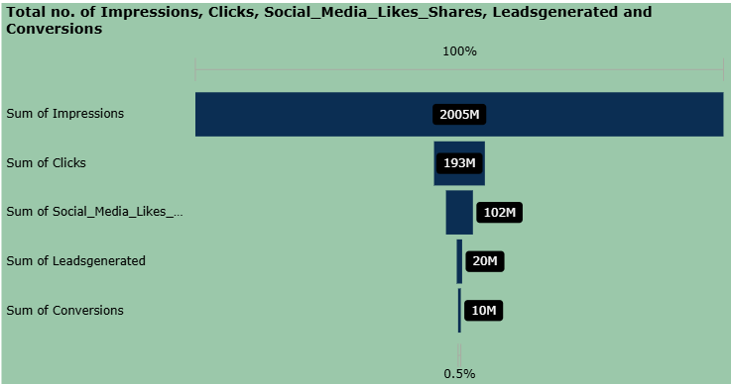
Marketing Funnel Analysis — Impressions to Conversions
customer journey from campaign reach to final customer conversions.
5 Funnel Stages
Only 0.5% of total impressions became final customers.

Slide 15
Marketing Funnel Analysis — Impressions to Conversions
Quick wins:
Optimize campaign timing and regional targeting.
Long-term strategies:
Makes Changes in UI part of website

Slide 16
Conclusions
This Project analyze GlowUp Marketing Campaign ROI Analysis to provide necessary business recommendations to identify which campaigns and channels generate the highest ROI
glow Blueprint has the Highest ROI, particularly in events. So, is the Best campaign
Social Media has less response compared to other channels, among all types of audiences respond equally.
Only 0.5% of total impressions became final customers.
Based on the insights, the company should focus more on high-performing campaigns, improve audience targeting to improve future marketing performance and revenue growth.
Overall, this project shows how Microsoft Power BI and business analytics can help companies make smarter marketing decisions.

Slide 17

Thank You
Any Questions/feedback?
Check out Working Model Here:
Case Study 4 GlowUp Marketing Campaign ROI Analysis
Connect me at:
Sai Jhansi Kongara

